Slide 1



Scrum-agile Teams & Roles
Joshua Brown

Slide 2

Product Owner
Responsibilities:
Represent the interest of clients
Ensure clients get the most value from the product.
Meet with clients on a regular basis to discuss the progress and any changes in the project.
Creates epics and breaks them down into user stories to add them to the product backlog for the Scrum Team to complete.

Slide 3

Scrum Master
Facilitates all aspects of Scrum.
Creates Project Charter to set precepts for the Scrum Team.
Facilitates Scrum meetings
Manages the production of Scrum & the Scrum Team by interceding on their behalf, removing any hindrances, and giving the team advice.

Slide 4

Testers
Part of the Scrum Team that provides test cases for the user stories.
Helps decide the order of user stories and what stories will be taken into the Sprint.
Tests code to make sure it is functional and secure.
May also have to serve as a developer.

Slide 5

Developer
Part of the Scrum Team that programs the code for the user stories to meet the test cases.
Helps decide the order of user stories and what stories will be taken into the Sprint.
Writes code using secure programming practices and patterns.
May also have to serve as a tester.

Slide 6
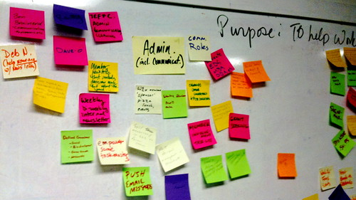
Sprint Planning
The product owner negotiates with the Scrum Team on what user stories will be carried into the Sprint.
Scrum Team decides the amount of time to dedicate to each story and their priority level.
Importance: Ultimately decides what each Sprint will focus on.
This Photo by Unknown Author is licensed under CC BY

Slide 7
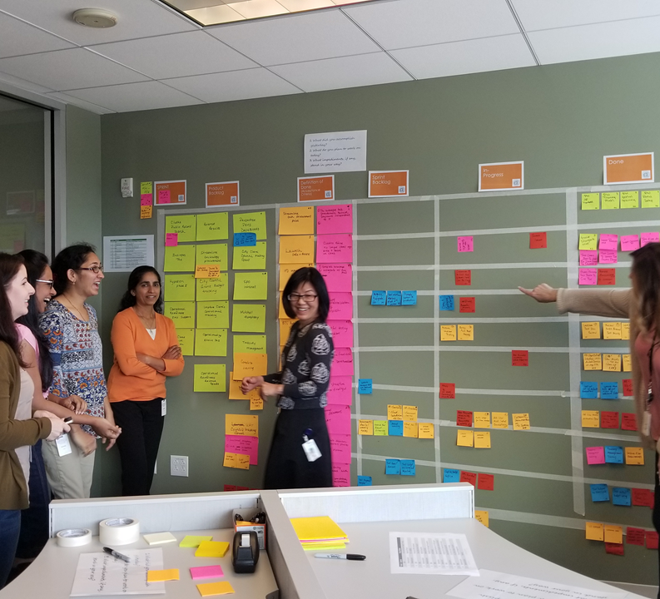
Daily Standup
The Scrum Team will briefly discuss the work they accomplished the previous day, the work they plan on doing today, and any possible hindrances to the completion of their work.
Importance: Helps track the team’s progress and identify any trouble areas.

Slide 8
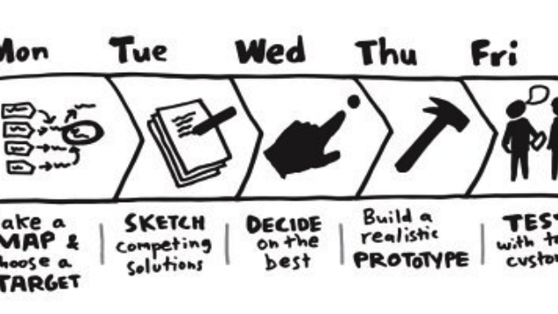
Sprint Review
A formal meeting with the product owner and clients at the end of each Sprint that showcases the work done in the sprint.
Importance: From this meeting, the product owner will officially sign off on the work of the sprint, or if more work is needed add it to the backlog of a future Sprint.
This Photo by Unknown Author is licensed under CC BY-NC-ND

Slide 9
Sprint Retrospective
A meeting facilitated by the Scrum Master where the Scrum Team reflects on the efforts during the Sprint before going into a new Sprint.
Importance: Allows the team to re-evaluate what they did well and what they did poorly on so that they can learn from the experience and continue to grow as a team.

Slide 10
SNHU Travel Waterfall VS. Agile Approach

Slide 11
Waterfall approach
Agile Approach
A lot of planning, documentation, and price budget calculations are involved before the project begins.
Throughout the project stages, a one-way motion of development would not account for any major mistakes or changes.
Changes in the product specifications would result in a costly halt of production and a restart of the projection.
If changes were not allowed, it is possible that the client would be left with an undesirable product that may be obsolete by the time the product is finished.
Requires less planning and less defined scope at the start of the project; however, over time the scope would become more defined.
As tasks are organized into stories, and stories are divided and focused on in the Sprints, the Scrum team only works on elements defined for that Sprint.
Because the Sprints aren’t defined too far in advance, there is room for change, and change is expected.
Change can be adequately evaluated to determine if it can be handled in the current Sprint or if it needs to be added to the backlog of a future Sprint.

Slide 12
Waterfall VS. Agile Approach Reflection

Slide 13
Reflection
Waterfall approach
Agile Approach
Great for projects that absolutely need a lot of detail upfront or where work can’t proceed without the initial scope and planning requirements.
The customer knows exactly what they want.
It is certain without a doubt that the project won’t change.
Agile seems like the perfect approach when it comes to an adaptive market.
Great for projects where the customer may not necessarily know what they want.
Projects that would benefit from a rapid or quick release, and can be continually worked on and updated after the initial release.

Slide 14
References
Cobb, C. G. (2015). The Project Manager’s Guide to Mastering Agile: Principles and Practices for an Adaptive Approach. Wiley.

